Slide 1



Virtual Reality

Slide 2
Table of contents
What is VR?
History
Companys, and VR Headset models
Technology
Sources

Slide 3
What is VR?
VR(Virtual Reality) is a simulation of a world similar or completly differnet to the real world which is used for gaming, education(school, military, space Agencys), and even business.
The umbrella term “VR” also contains AR, and Mixed Reality

Slide 4
History
One of the First companys to develop VR technology was nasa in the 1970s - 1980s
First commercial „VR“ headsets was developed by Nintendo in 1995
Only after 2010 VR became popular again with the Oculus rift by Oculus
In 2014-2015 multiple VR headsets would be announced including the HTC (Vive), Playstation VR and google cardboard
In 2019 The Value Index was announced, the same year the Oculus quest came to the market
Because of the Covid pandemic it has become a thriving industry expecting to rise to 62 Billion $ by 2027

Slide 5
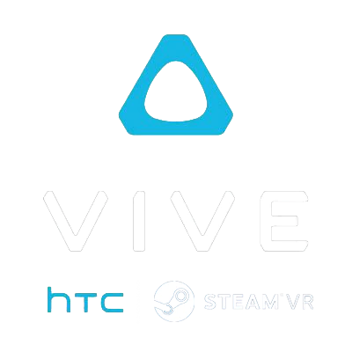


Companys

Slide 6
Technology Different tracking solutions
Oculus CV1; Constellation Tracking
Vive, Valve; Lighthouse Tracking
Oculus Quest1-2; Oculus Insight

Slide 7
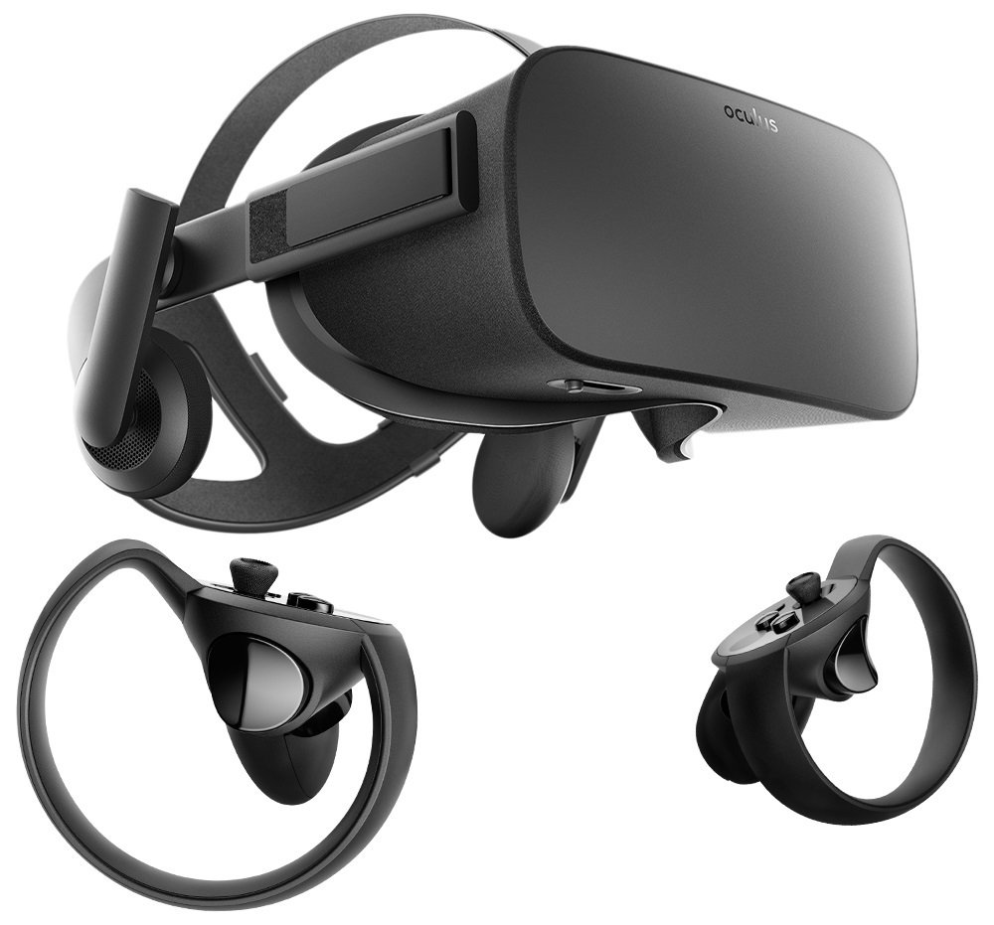
Oculus Rift
Notes:
Uses Set Cameras to see Infrared LEDs on the headset, the headset and controllers will be able to be tracked by the position and shapes of the led dots

Slide 8
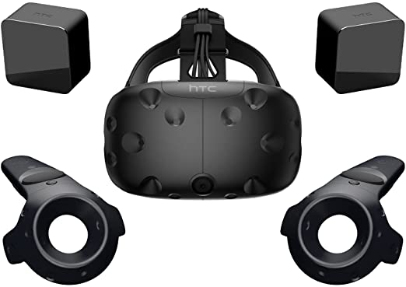
HTC Vive
Notes:
Other then the rift the cameras are on the headset and sees where the base stations and controllers are reletive to itself

Slide 9
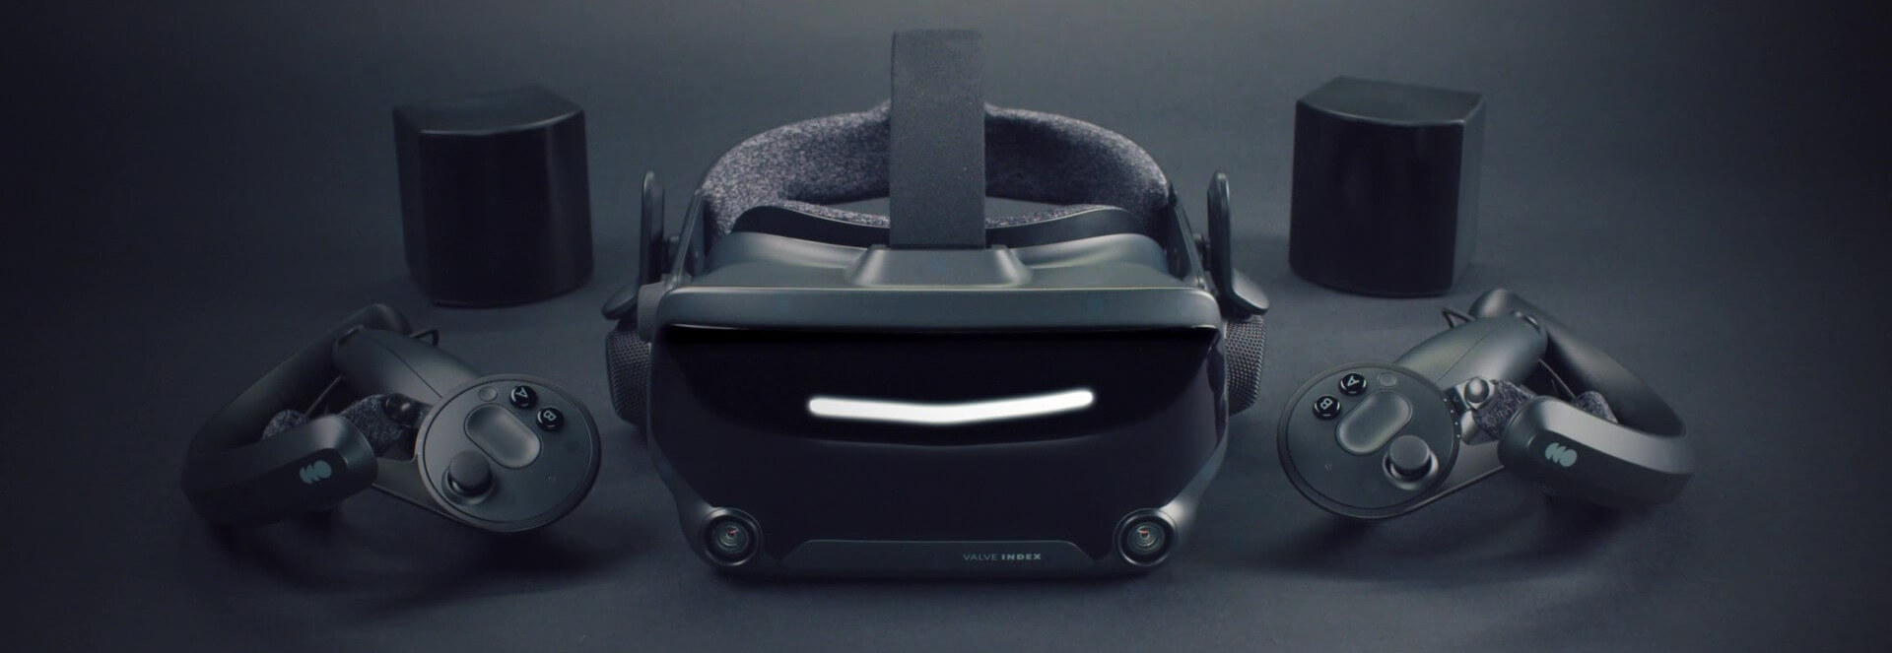
Valve Index
Notes:
Same system to the vive

Slide 10
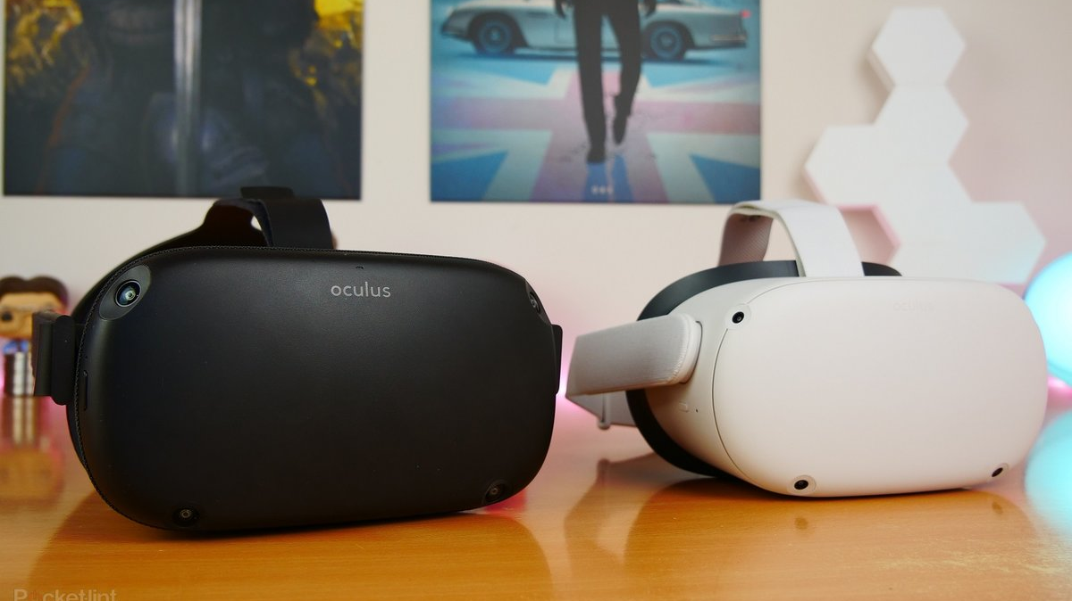
Oculus Quest & Quest 2
Notes:
Uses cameras to see the enviorment to generat an image of the room and position itself in it using AI and seeing the controllers same as the Valve and Vive

Slide 11
Sources
https://en.wikipedia.org/wiki/Virtual_reality
https://en.wikipedia.org/wiki/Augmented_reality
https://en.wikipedia.org/wiki/Mixed_reality
https://xinreality.com/wiki/Lighthouse#:~:text=Lighthouse%20calculates%20When%20the%20photosensor,of%20the%20room%20is%20established.
https://ai.facebook.com/blog/powered-by-ai-oculus-insight/#:~:text=Oculus%20Insight%20computes%20an%20accurate,to%20track%20the%20controller%20positions.
https://en.wikipedia.org/wiki/Simultaneous_localization_and_mapping
https://xinreality.com/wiki/Constellation

